Slide 1

Predictive Factors of Occupational Change

Slide 2
The group
Casalingo Fabio
Coaro Michele
El Kouch Inas
Zanone Edoardo

Slide 3

Table of Contents
(0,0,1)
(0,0,2)
(0,0,3)
The Dataset
Data Analysis
Conclusion
Structure
Challenges
Data preparation
Outlier Treatment
Unsupervised Learning
Supervised Learning
Model evaluation and final remarks

Slide 4
(0,0,1)
The Dataset

Slide 5
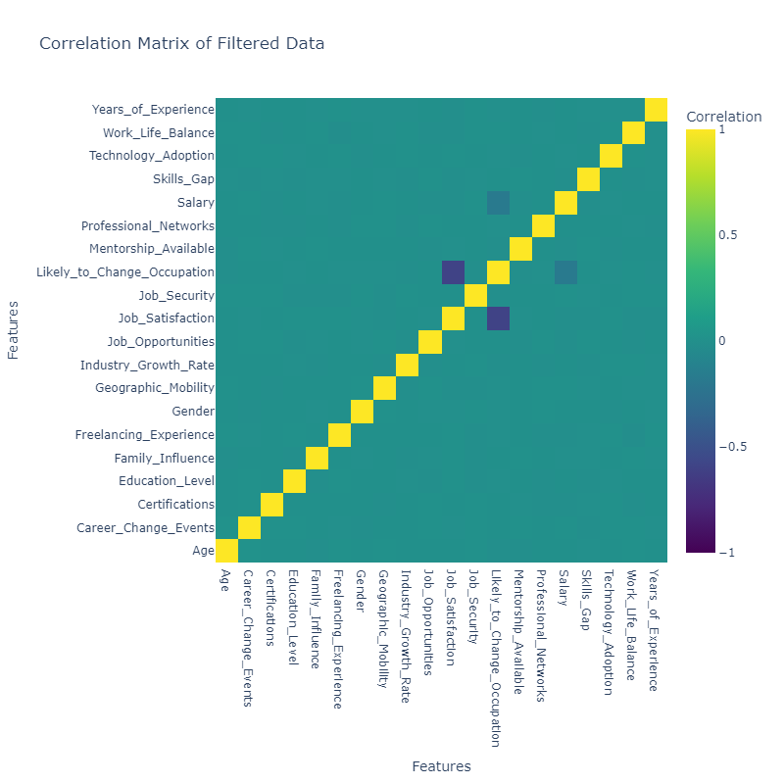
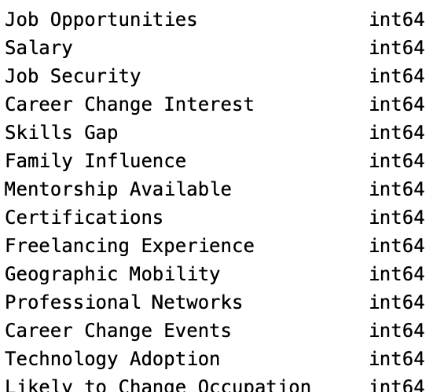
Structure

Slide 6
Challenges of the dataset
Encoding variables
Understanding categorical variables treatment process
Low correlation of variables

Slide 7
Data Preparation
Mapping
Variable of Interest
Column removal
Standardization
Qualitative into quantitative variables
Identified in likelihood of changing occupation
Exclude less relevant data in supervised approach
Replacing missing values with underscores

Slide 8
(0,0,2)
Data Analysis

Slide 9

Outlier treatment
Distances
MCD
Cook’s Distance
Mahalanobis Distance
Minimum Covariance Determinant

Slide 10
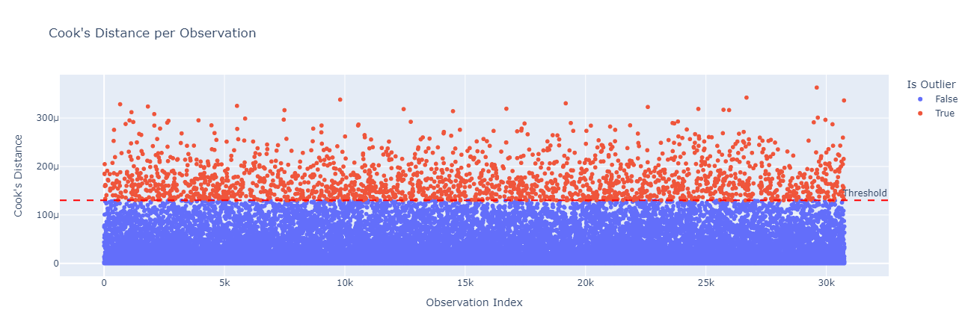
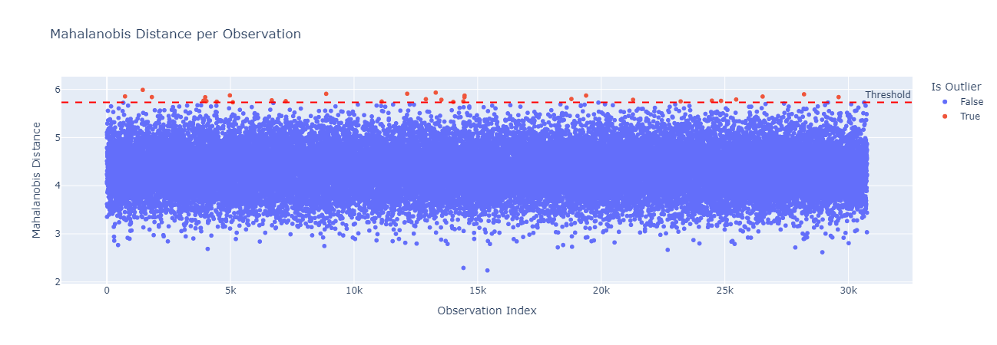

Slide 11
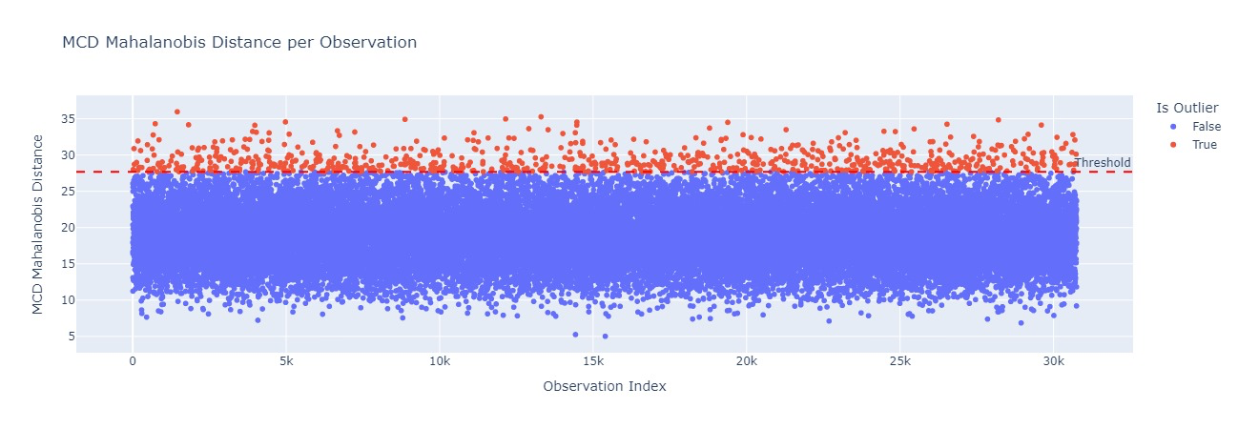

Slide 12
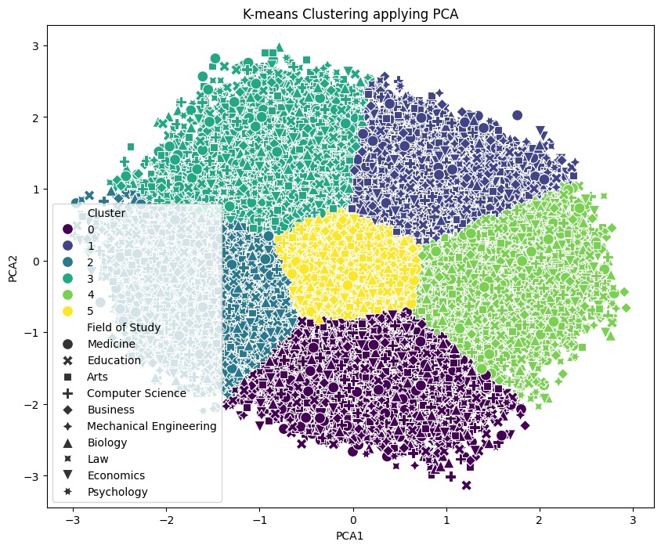
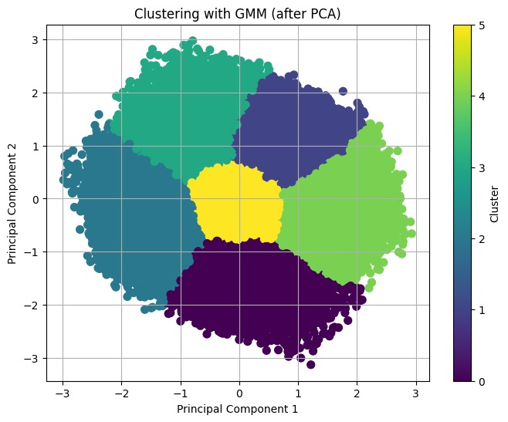
Unsupervised Learning - clustering

Slide 13
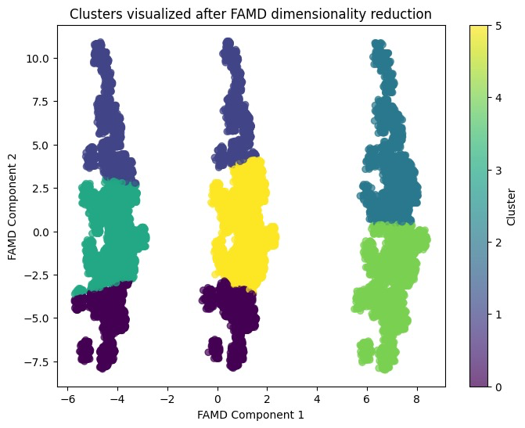
Unsupervised Learning - famd

Slide 14
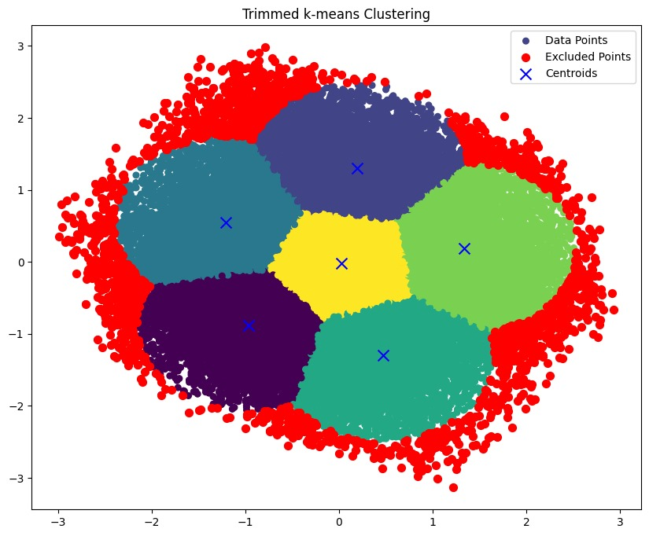
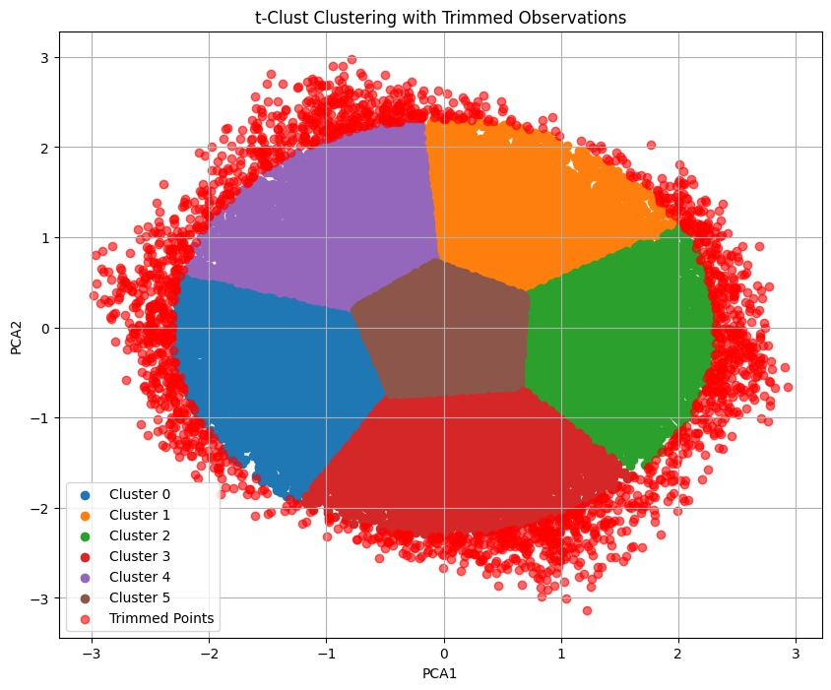
Unsupervised Learning – robust clustering

Slide 15
(0,0,3)
Supervised

Slide 16
Supervised learning – the models
Logistic regression
Random Forest
Mixed Effect Model
With and without HC1 Covariance Type
To mitigate overfitting
Combining fixed and random effects

Slide 17
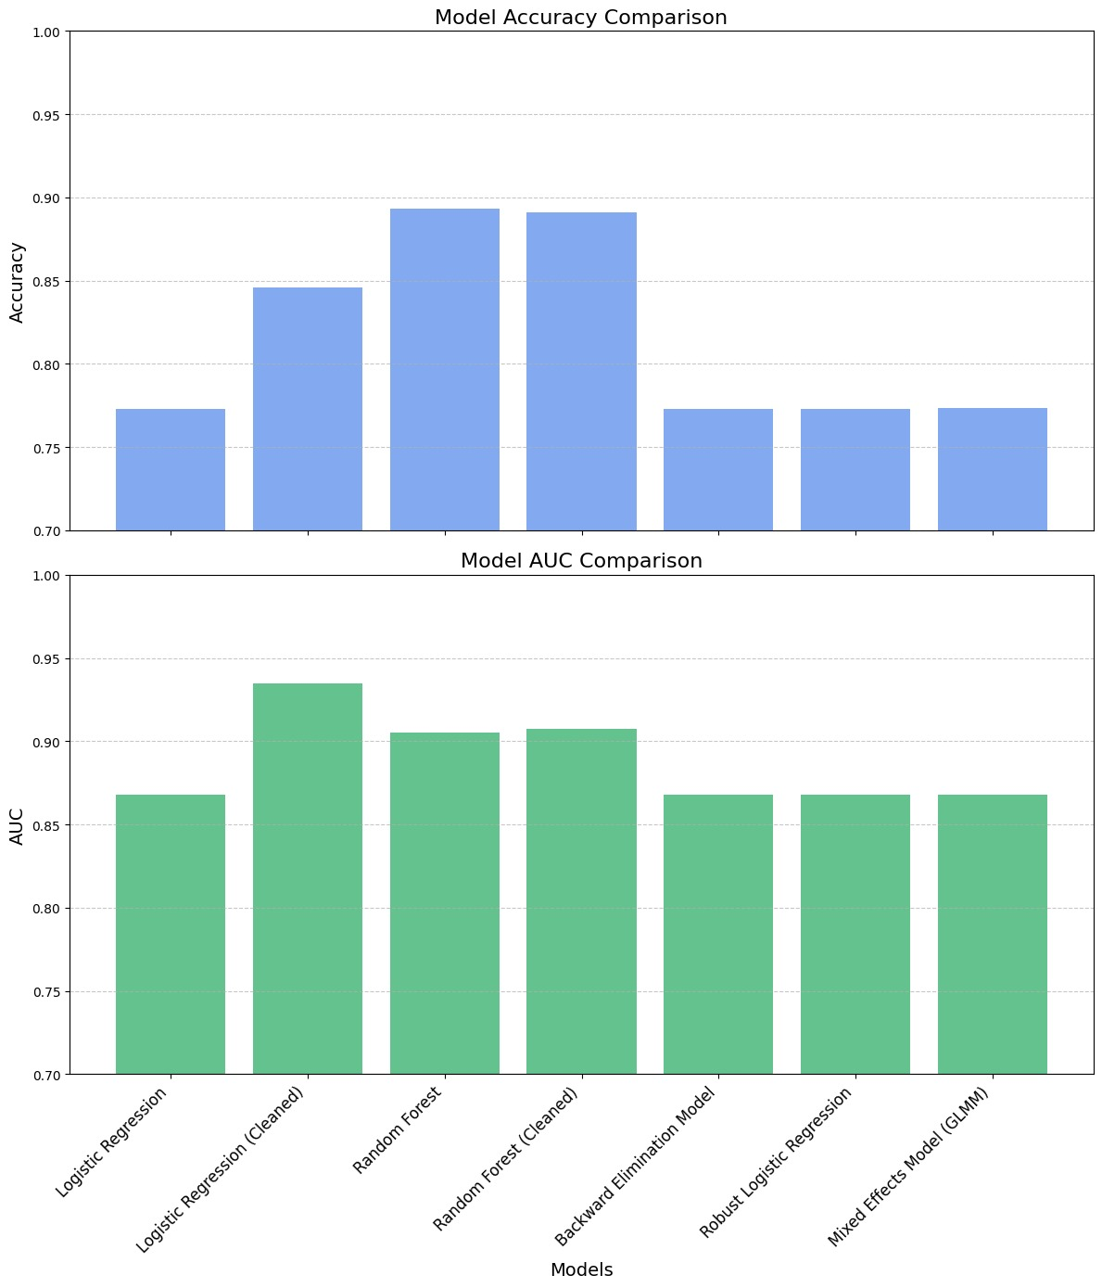
Supervised learning - Summary

Slide 18

Conclusions

Slide 19




We fought hard, but…
The Process
Analytic Pipeline
Data preparation
The DATA
All the methods have been implemented properly
The steps have been planned in a sensible way
The respective data categories have been treated coherently
THE DATASET DID NOT CONTAIN ENOUGH INFORMATION FOR THE ANALYSIS

